Slide 1

Charging station Optimization
Stockless Vehicle in Louisville
Members: Jiameizi Yao, Yue (Alex) FU

Slide 2
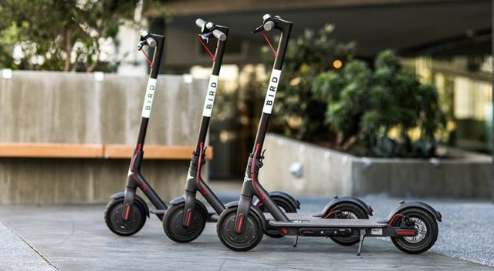
Background
Many cities especially Louisville has been promoting the dockless vehicles (scooter bikes) in the city for couple years.
Advantages:
Fun and easy to ride
Convenient
Reduce public transportation pressure
Cheap and environment friendly

Slide 3
Problem Description
The current operation pattern for the scooter company in Louisville has some drawbacks.
Companies pay freelancers and ask them to collect and charge the vehicles on their own. They get paid even more if the vehicles has not been collected for a long time. There is a phenomenon where people lock up the vehicles and wait for the reward to increase before actually collect these vehicles.
Hence, we would like to set several charging stations in the city to serve the vehicles which need to be charged or collected. And our objective is to minimize the total distance between the vehicles and charging stations in order to provide the most efficient and convenient services.

Slide 4
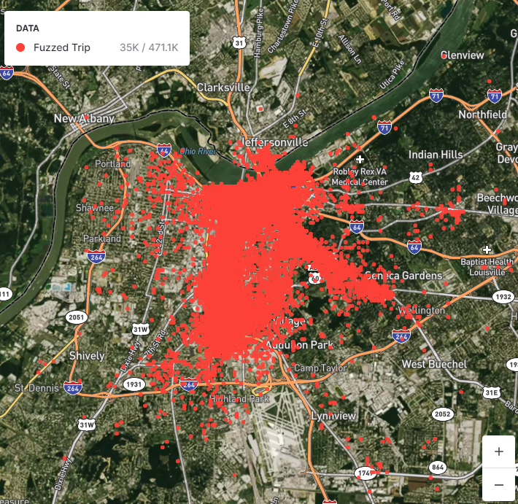
Data overview
Dockless Vehicle Trips (Jul 2018 – Jan 2020)
TripID
StartDate
StartTime
EndDate
EndTime
StartLatitude
StartLongitude
EndLatitude
EndLongitude

Slide 5
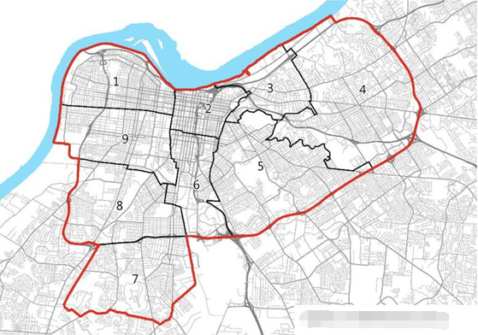
Data Overview
Dockless Vehicle Distribution Zones
Zones are divided and used for equitable distribution of vehicles across the city.
Dist_Zone: zone number
PI2040Area: area description (e.g. East Core)
Geometry info: set of coordinates on the edge of each zones

Slide 6
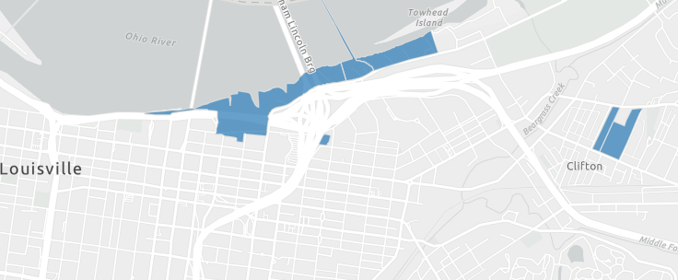
Data Overview
Dockless Restricted Areas
Similar to the distribution zones, the set of coordinates on the edge of each restricted areas, if connect these points in sequence, will end up a polygon shape on the map.

Slide 7
How to define vehicles
The data that Louisville government establish about the dockless vehicle trips has removed vehicle ID for privacy concerns. In order to find every single vehicle with aggregated trips, we use start/end time and start/end location to roughly restore trips into their belonging vehicles.
To narrow down the dataset and cover the variation among different seasons, we choose 1st day in each month and find the vehicles. (2018-9-1 to 2020-1-1)
Typically, we assume that trips with start/end time and start/end location exactly matched all belong to one vehicle. And we end up with 8,655 vehicles as our observations.

Slide 8
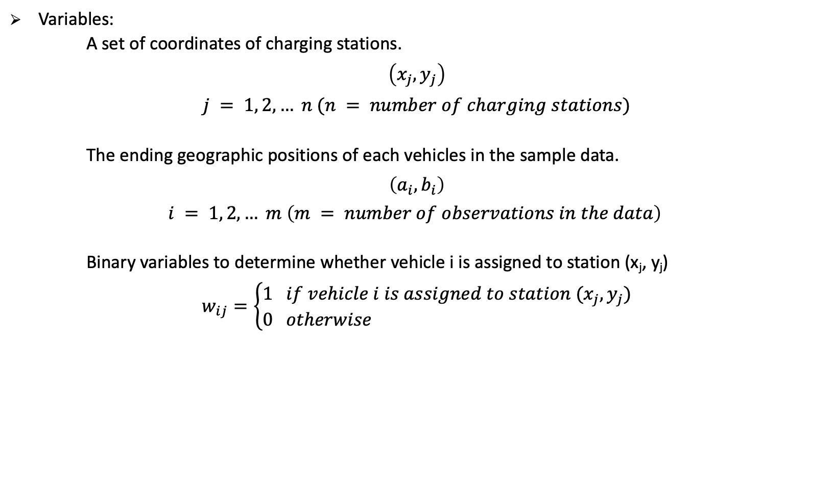
Model
Variables:
A set of coordinates of charging stations.
$$\left(x_{j}, y_{j}\right)$$
$$j = 1, 2, … n (n = number of charging stations)$$
The ending geographic positions of each vehicles in the sample data.
$$\left(a_{i}, b_{i}\right)$$
$$i = 1, 2, … m \left(m = number of observations in the data\right)$$
Binary variables to determine whether vehicle i is assigned to station (x_{j}, y_{j})
$$w_{ij}=\left\{\begin{aligned}1 if vehicle i is assigned to station (x_{j}, y_{j}) \\ 0 otherwise \end{aligned}\right.$$

Slide 9
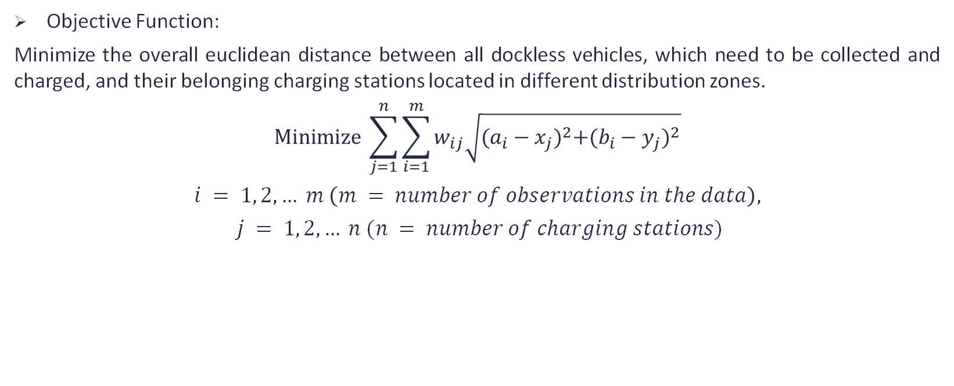
Model
Objective Function:
Minimize the overall euclidean distance between all dockless vehicles, which need to be collected and charged, and their belonging charging stations located in different distribution zones.
$$Minimize \sum_{j=1}^{n}{\sum_{i=1}^{m}{w_{ij}\sqrt{{(a_{i}−x_{j})}^{2}+{(b_{i}−y_{j})}^{2}}}}$$
$$i = 1, 2, … m \left(m = number of observations in the data\right),$$
$$j = 1, 2, … n (n = number of charging stations)$$

Slide 10
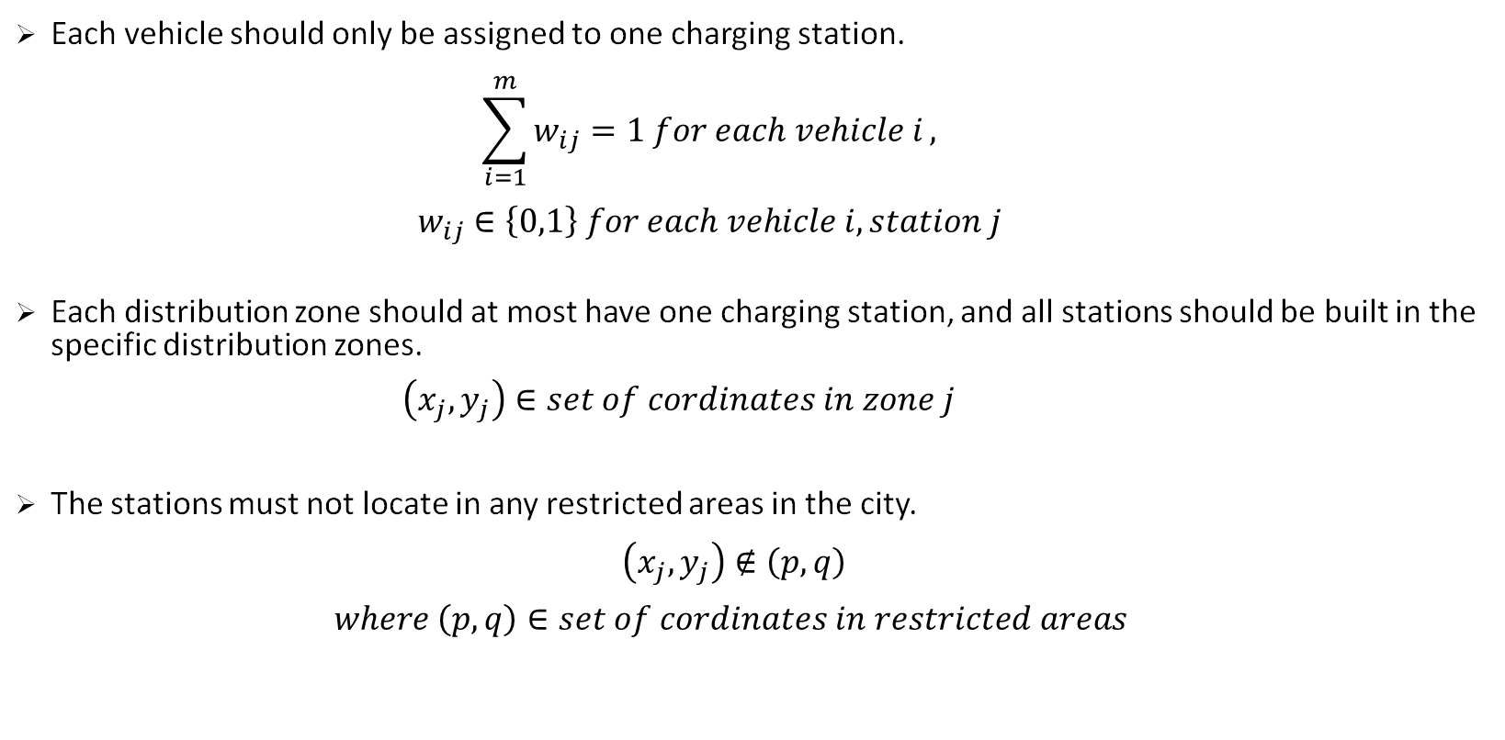
Constraints
Each vehicle should only be assigned to one charging station.
$$\sum_{i=1}^{m}{w_{ij}=1 for each vehicle i},$$
$$w_{ij}∈\left\{0,1\right\} for each vehicle i, station j$$
Each distribution zone should at most have one charging station, and all stations should be built in the specific distribution zones.
$$（x_{j}, y_{j}）∈set of cordinates in zone j$$
The stations must not locate in any restricted areas in the city.
$$（x_{j}, y_{j}）∉\left(p, q\right)$$
$$where \left(p, q\right)∈set of cordinates in restricted areas$$

Slide 11
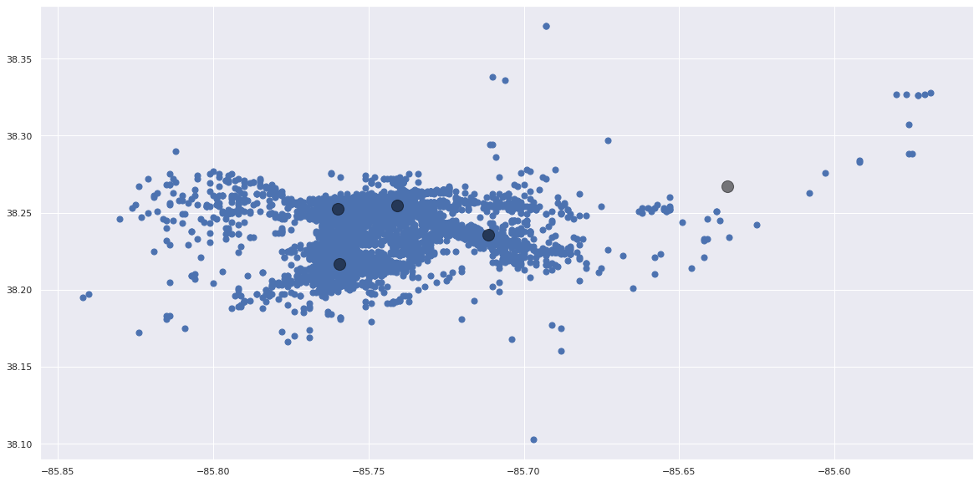
K-mean Clustering
Latitude
Longitude

Slide 12

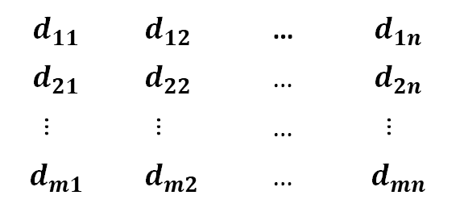
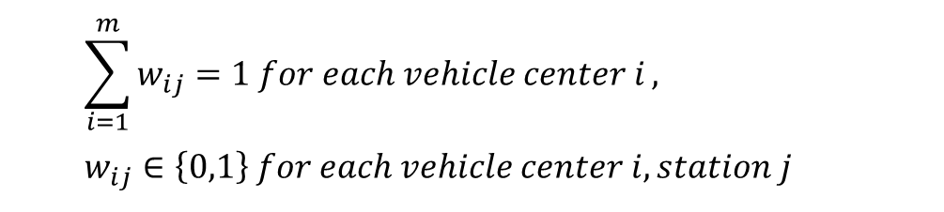
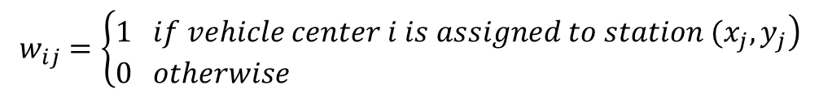
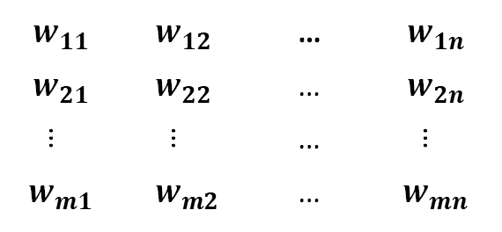
Approach Description
$$d_{11}$$ | $$d_{12}$$ | … | $$d_{1n}$$
$$d_{21}$$ | $$d_{22}$$ | … | $$d_{2n}$$
… | … | … | …
$$d_{m1}$$ | $d_{m2}$ | … | $$d_{mn}$$
$$w_{11}$$ | $$w_{12}$$ | … | $$w_{1n}$$
$$w_{21}$$ | $$w_{22}$$ | … | $$w_{2n}$$
… | … | … | …
$$w_{m1}$$ | $w_{m2}$ | … | $$w_{mn}$$
d =
X
w =
$$d_{ij}=\sqrt{{\left(a_{i}−x_{j}\right)}^{2}+{\left(b_{i}−y_{j}\right)}^{2}}$$
$$for each vehicle center i to each station j$$
$$w_{ij}=\left\{\begin{aligned}&\left.1 if vehicle center i is assigned to station (x_{j}, y_{j}\right) \\ &0 otherwise \end{aligned}\right.$$
$$\sum_{i=1}^{m}{w_{ij}=1 for each vehicle center i},$$
$$w_{ij}∈\left\{0,1\right\} for each vehicle center i, station j$$

Slide 13
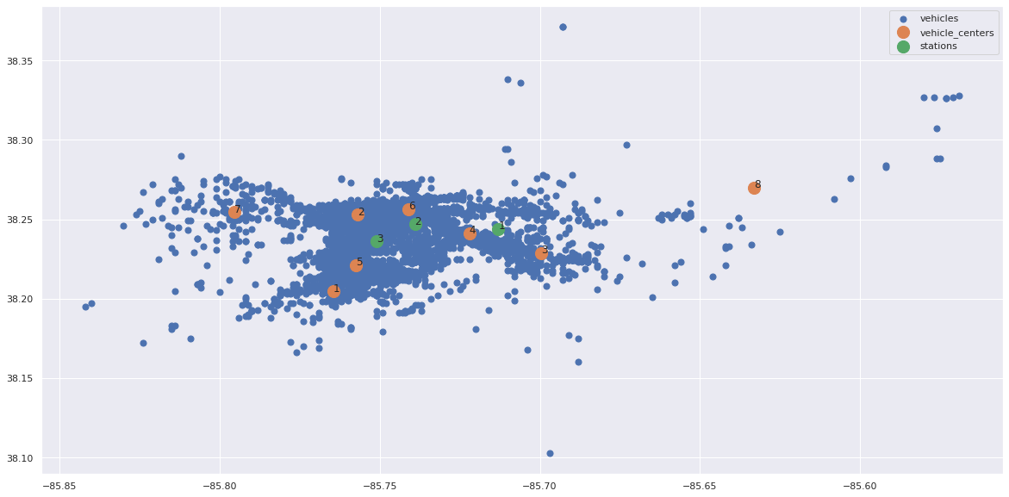
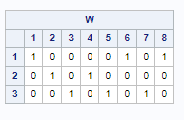

Result

Slide 14
Thank you

